Slide 1
CSS
Website stylization

Slide 2
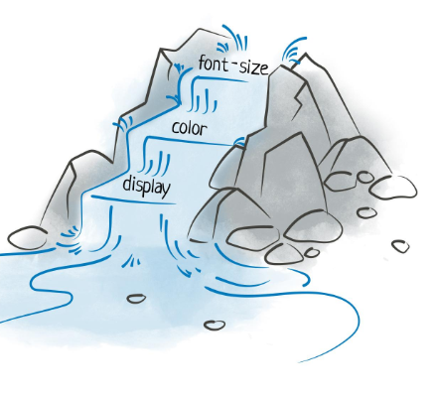
CSS
CSS is an acronym for Cascading Style Sheets. 💡 What do you mean by "cascading"? 👉 Let's imagine a waterfall – water flows from one level to another. 👉 Also, CSS styles are applied from the most general to the most specific rules. 👉 This allows for design control and flexibility. Tables).

Slide 3
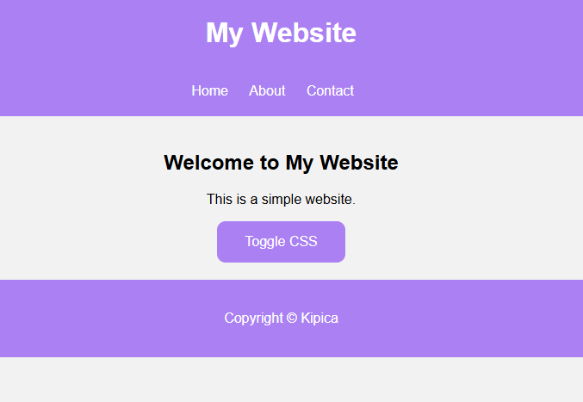
CSS
🎨 CSS transforms plain HTML into an attractive design! 🔹 No CSS – sites are plain, black and white, and boring.
🔹 With CSS – we can change: 🎨 Colors 🔤 Fonts 🖼 Background images 📏 Arrangement and size of elements ✨ Animations and effects
Notes:
https://dinoduvnjak.github.io/css-toogle/
https://developer.mozilla.org/en-US/docs/MDN/Guides

Slide 4
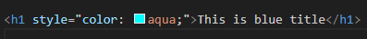
CSS-INLINE CSS
👉 Suitable when you want to quickly change the style of only one element
Problem with Inline CSS 🔹 Difficult to maintain 🔹 Not practical for multiple elements 🔹 It is not used often, except for quick changes
Notes:
https://dinoduvnjak.github.io/css-toogle/
https://developer.mozilla.org/en-US/docs/MDN/Guides

Slide 5
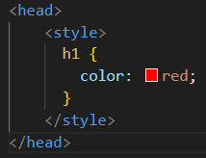
CSS-INTERNAL CSS
👉 Can be used to style the entire page
Problem with Inline CSS 🔹 If the site has multiple HTML pages, you have to repeat the styles in each file
Notes:
https://dinoduvnjak.github.io/css-toogle/
https://developer.mozilla.org/en-US/docs/MDN/Guides

Slide 6
CSS-INTERNAL CSS
👉 Can be used to style the entire page
Problem with Inline CSS 🔹 If the site has multiple HTML pages, you have to repeat the styles in each file
Notes:
https://dinoduvnjak.github.io/css-toogle/
https://developer.mozilla.org/en-US/docs/MDN/Guides

Slide 7
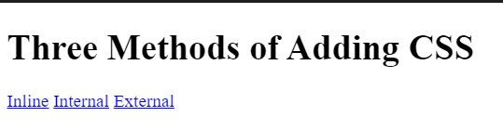
CSS – EXERCISE 1
✅ Objective: Create a page with three links that change the color of the text using all three methods. ✅ Steps: 1️⃣ Create index.html 2️⃣ Add inline.html, internal.html and external.html 3️⃣Uses inline, internal, and external CSS to style titles
Notes:
https://dinoduvnjak.github.io/css-toogle/
https://developer.mozilla.org/en-US/docs/MDN/Guides

Slide 8
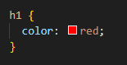
CSS-ELEMENT SELECTORS
💡CSS selectors allow us to select HTML elements and apply styles to them
👉 Apply the style to all h1 elements and HTML files
⚠ Caution! Element selectors apply a style to all HTML elements of that type
Notes:
https://dinoduvnjak.github.io/css-toogle/
https://developer.mozilla.org/en-US/docs/MDN/Guides

Slide 9
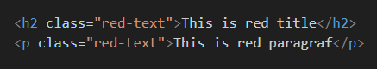
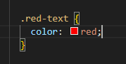
CSS-CLASS SELECTORS
💡CSS selectors allow us to select HTML elements and apply styles to them
👉 Classes are used to group multiple elements that share the same style 👉 You can add the same class to multiple elements!

Slide 10
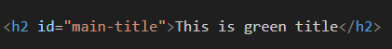
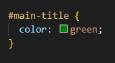
CSS-ID SELECTORS
👉 The ID is unique and is used when you want to style only one element 👉 Each ID must be unique in the HTML document! 👉 Use IDs only when really needed!

Slide 11
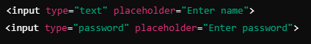
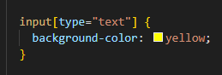
CSS-ATTRIBUTE SELECTORS
👉 With this selector, we can target HTML elements that have a specific attribute 👉 Apply the style only to <input> elements with type="text"

Slide 12
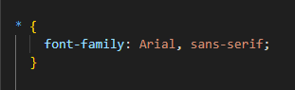
CSS-UNIVERSAL SELECTORS
👉 Apply style to ALL elements in an HTML document 👉 Useful for resetting styles at the beginning of a CSS file!

Slide 13
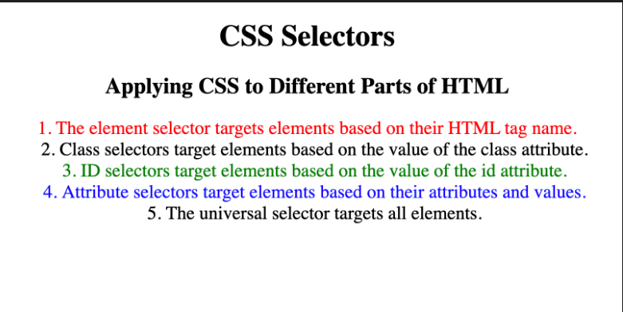
CSS – EXERCISE 2
✅ Objective: Add colors using named colors, HEX, and RGB values. ✅ Steps: 1️⃣ Set the background-color of the page to antiquewhite. 2️⃣ Set the color to h1 using named colors. 3️⃣ Set the color for h2 using the HEX code. 4️⃣ Set background-color for h1 using HEX code. 5️⃣ Set the color for h2 using the RGB value.

Slide 14
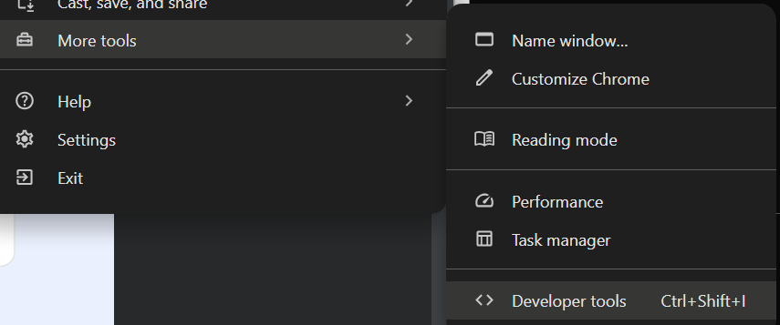
CSS-CHROME DEVELOPER TOOLS
✅ Enable inspection of HTML and CSS code ✅ Detect and test CSS rules ✅ Change live styles without changing the original code ✅ Overview of automatically assigned browser styles
🔹 Method 1: Via Menu 1️⃣ Click on the three dots in the top right corner of Chrome 2️⃣ More Tools → Developer Tools 🔹 Method 2: Keyboard Shortcuts 📌 Windows/Linux: Ctrl + Shift + I or F12 📌 Mac: Cmd + Option + I 🔹 Method 3: Right Click (Fastest!) 1️⃣ Right-click on any element on the web page 2️⃣ Click Inspect

Slide 15
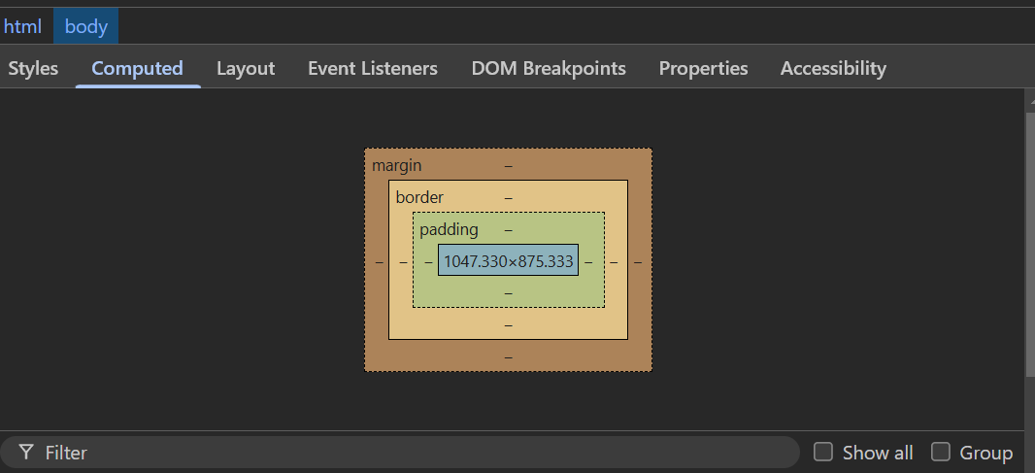
CSS-CHROME DEVELOPER TOOLS
👉 The "Computed" tab shows the final result of all applied CSS rules. ✅ Displays all the colors, margins, fonts, and other properties of an element ✅ Ignores strikethrough rules that are not active ✅ Allows you to diagnose problems faster Example: If the color of the text does not appear as you expected, you can see in the Computed section which CSS rule takes precedence.

Slide 16
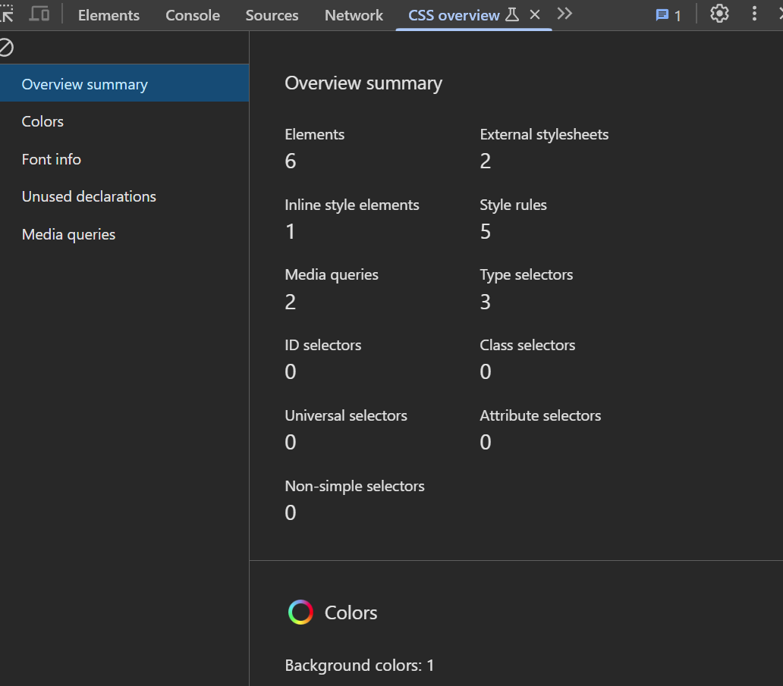
CSS-CHROME DEVELOPER TOOLS
✅ All colors on the page (background, text, links) ✅ What fonts are used ✅ What font sizes are applied
🔍 Useful trick: If you see an interesting color on a web page, you can use CSS Overview to quickly get its code and use it in your project.

Slide 17
CSS-BOX MODEL
Each HTML element consists of:
Content – Text, image, paragraph, title, etc. Padding – Inner Spacing Between Content and Border Border – A line that surrounds an element Margins – The space between an element and other elements

Slide 18
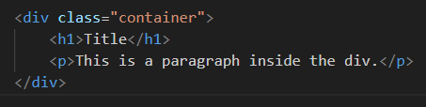
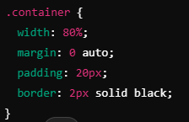
CSS-DIV ELEMENT
👉 Sometimes it is necessary to group elements into "containers" to make it easier to add styles to them. 👉 <div> It allows flexibility in the arrangement of elements on the page.

Slide 19
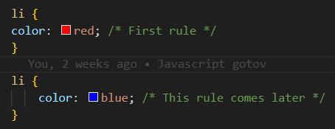
CSS-CASCADE AND SPECIFICITY
💡How CSS decides which style to apply when there are multiple rules for the same element
👉A rule that is lower in the CSS file has a higher priority and can override predefined rules. 👉 The text <li> will be blue, because the second rule comes later and overruns the first.

Slide 20
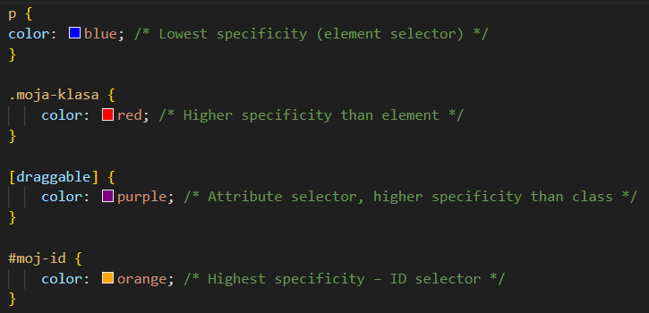
CSS-STYLE TYPE PRIORITY
👉The CSS specificity determines which selector takes precedence. Rules with more specifics will beat less specific ones. 1️⃣ Element selector (p, li, h1) 2️⃣ Class selector (.my-class) 3️⃣ Attribute selector ([type="text"]) 4️⃣ ID selector (#moj-id)

Slide 21
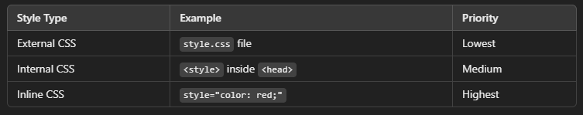
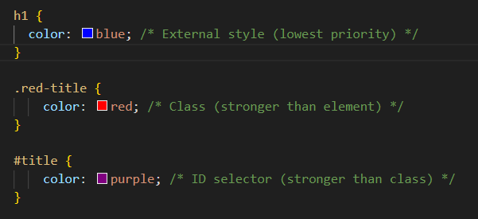
CSS-SELECTOR SPECIFICITY PRIORITY
👉The text will be green, as the inline style has the highest priority

Slide 22
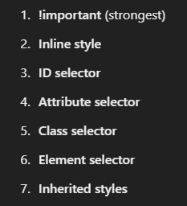
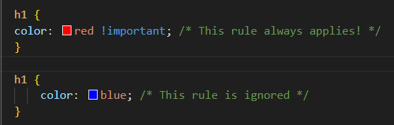
CSS-!important RULE
👉If you want to make sure that a rule always applies, use !important
Excessive use of !important can complicate the maintenance of CSS. Use it only when it's necessary.

Slide 23
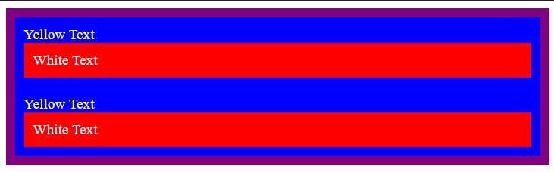
CSS – EXERCISE 3
👉Replicate site from image

Slide 24
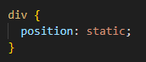
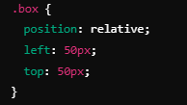
CSS – POSITIONING
Static (default)
Relative
👉Elements are lined up one below the other in HTML order
👉The element moves 50px to the right and 50px down, but does not affect the other elements.
👉 It doesn't move in relation to other elements, only to its original position.

Slide 25
CSS – POSITIONING
Absolute
Fixed
👉 An element moves relative to its nearest parent, which has position:relative 👉 If neither parent has a postion set, then it is positioned towards the upper left corner. 👉 Key problem with absolute: An element goes out of the normal flow of the document, so the other elements behave as if it doesn't exist.
👉 The element remains in the same place on the screen, even when the user scrolls. 👉 It is used for navigation, back to top buttons, chat windows, etc.

Slide 26
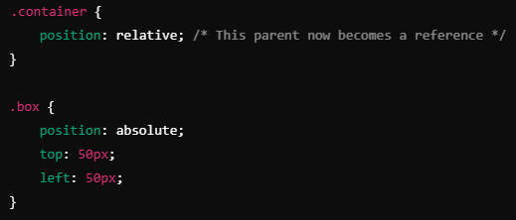
CSS – POSITIONING
Z-index
👉 The z-index determines which element goes above which in the "third dimension" (Z-axis). 👉 The higher the value of → element goes above the others.

Slide 27
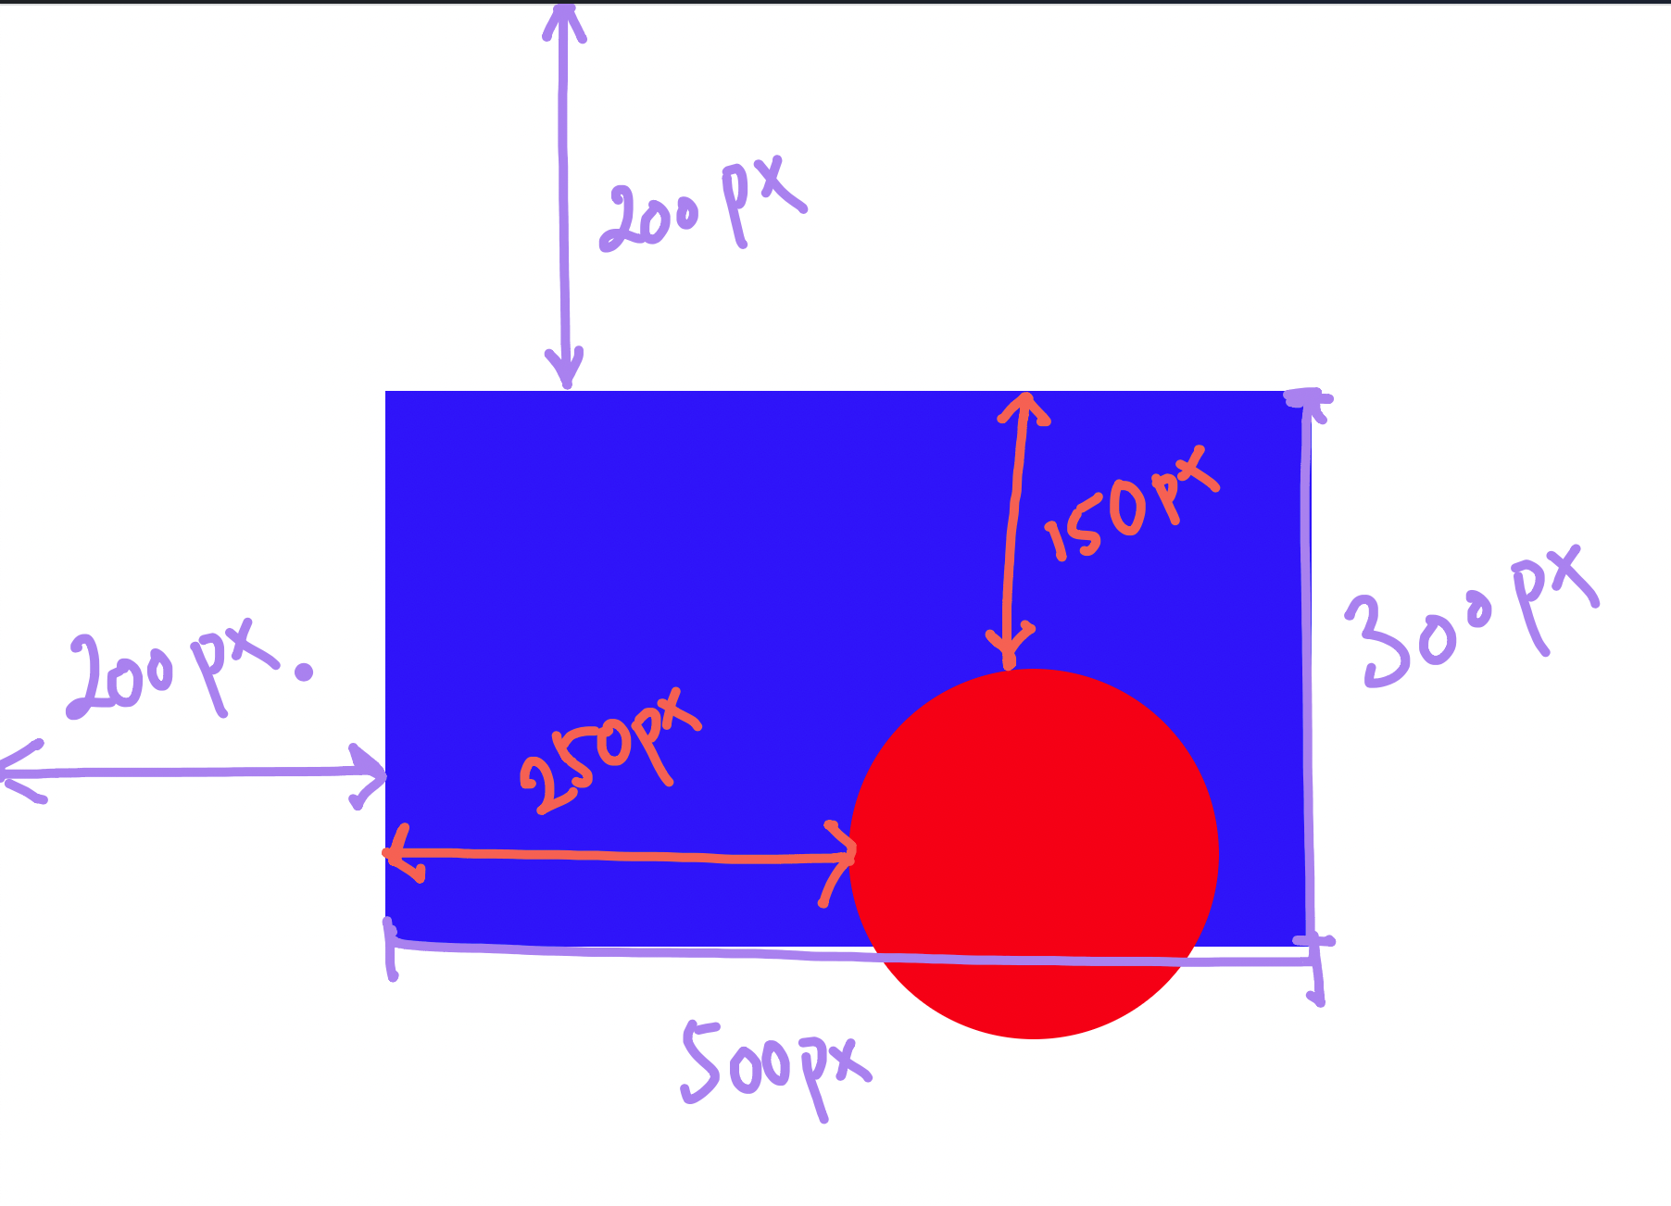
CSS – EXERCISE 4
👉Replicate site from image 👉 Read and go through the exercises at W3 schools
Notes:
https://www.w3schools.com/css/default.asp

Slide 28
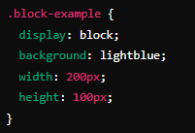
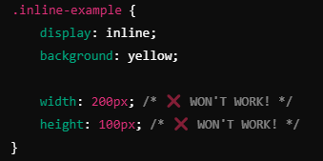
CSS – DISPLAY
Block
Inline
👉 By default, some HTML elements occupy the entire width of the page, even if their content is not wide. 👉 Examples: <p>, <div>, <h1>, <section>, <article>, <footer>.
👉 These elements only take up as much space as they need. 👉 We cannot set their width (widght) or height (height). 👉 Examples: <span>, <a>, <strong>, <em>. 👉 The elements will stand next to each other and ignore the width and height.

Slide 29
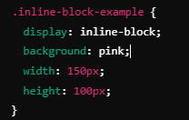
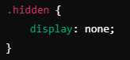
CSS – DISPLAY
Inline block – best from both worlds
None – hiding elements
👉 It combines the characteristics of block and inline elements. 👉 It can have width and height, but does not move to a new row if there is enough space. 👉 The elements will remain in the same row, but now we can adjust the width and height.
👉 It hides the element completely – as if it were not in HTML! 👉 It doesn't even take up space on the schedule. 📌 It is used for: Hide the menu until the user clicks the button. Removal of elements on the mobile versions of the site

Slide 30
CSS – DISPLAY
Inline block – best from both worlds
None – hiding elements
👉 It combines the characteristics of block and inline elements. 👉 It can have width and height, but does not move to a new row if there is enough space. 👉 The elements will remain in the same row, but now we can adjust the width and height.
👉 It hides the element completely – as if it were not in HTML! 👉 It doesn't even take up space on the schedule. 📌 It is used for: Hide the menu until the user clicks the button. Removal of elements on the mobile versions of the site

Slide 31
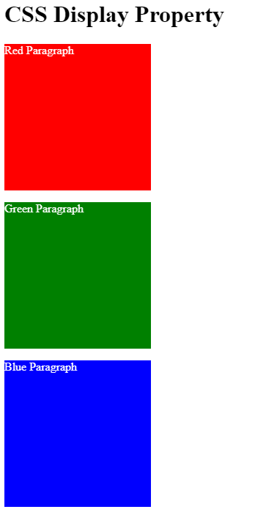
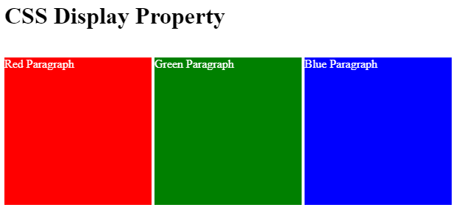
CSS – EXERCISE 5
👉Adjust the display so that the three squares stand in the same row. 👉 Adjust the display so that all the squares stand one below the other.

Slide 32
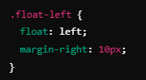
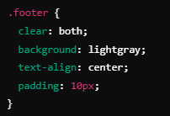
CSS – FLOAT
👉 Float allows us to wrap text around elements, such as images, and create designs with "floating" blocks
After elements that use float, sometimes it is necessary to clean the floating effect. 👉 We use clear: both; to ensure that the elements underneath are not stuck.
⚠️ Float is best for: ✅ Wrap text around a picture 🖼️ ✅ Simple Floating Elements

Slide 33
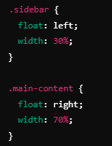
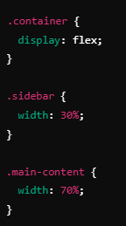
CSS – FLOAT
Good practice
Bad practice
🚫 Float is NOT a recommended technique for complex layouts. ✔ Better to use Flexbox and CSS Grid.

Slide 34
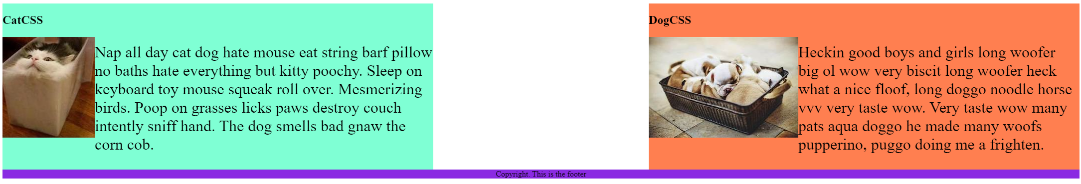
CSS – EXERCISE 6
👉Adjust the display so that the three squares stand in the same row. 👉 Adjust the display so that all the squares stand one below the other.

Slide 35
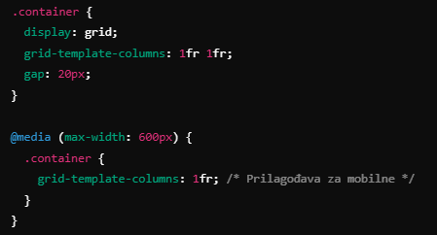
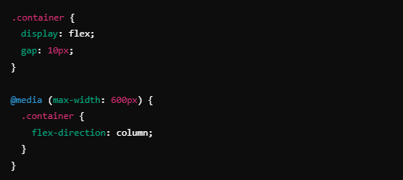
CSS – RESPONSIVNESS
CSS Grid
Flexbox
💻 Desktop → Two columns 📱 Mobile → Single Column
💻 Desktop → Elements are OK (horizontal) 📱 Mobile → Elements are stacked vertically
👉 It allows you to create complex layouts using rows and columns. 👉 CSS Grid is powerful for complex layouts and allows us to easily control the widths and heights of elements.
👉 Flexbox is great for navigation menus, buttons, and in-line arrangement of elements.

Slide 36
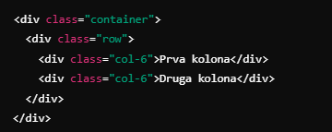
CSS – RESPONSIVNESS
Bootstrap
Alternatives
👉 TAILWIND CSS
👉 BULMA
👉 KENDO
💻 Desktop → 2 columns (50% - 50%) 📱 Mobile → Automatically moves to 1 column
👉 Bootstrap provides ready-made styles and predefined classes for a simple design without a lot of coding

Slide 37
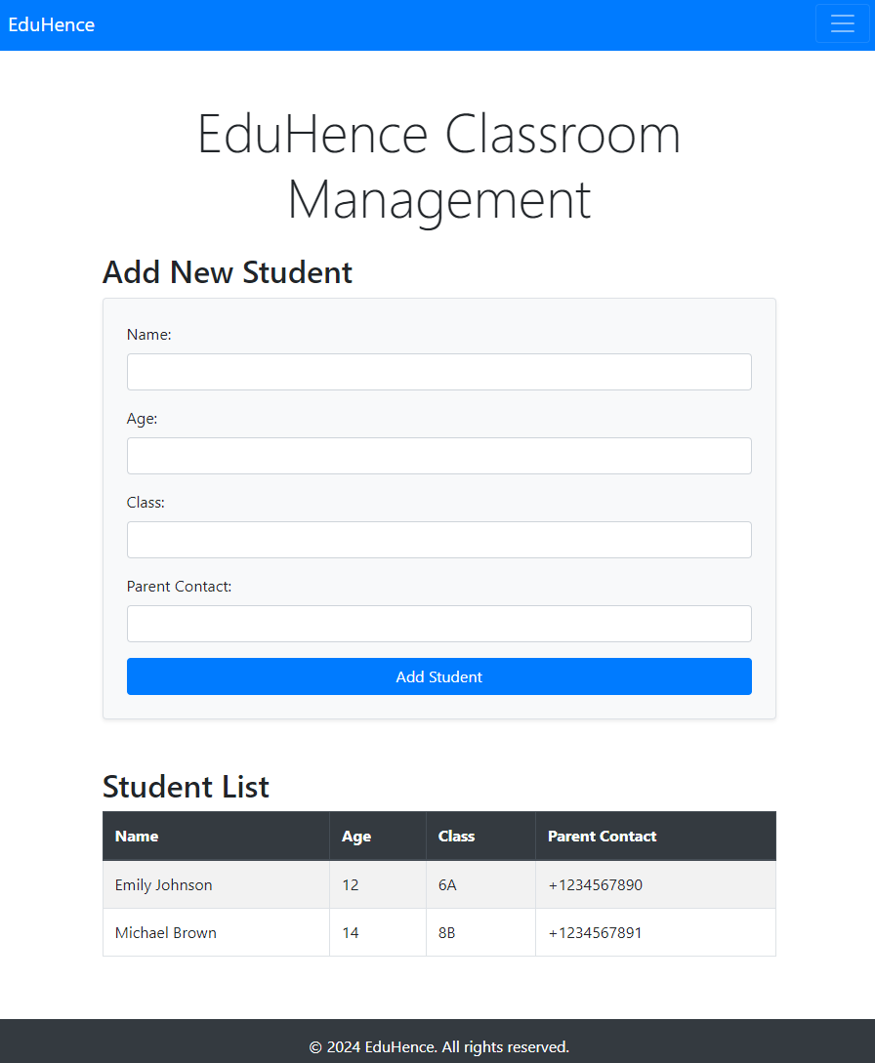
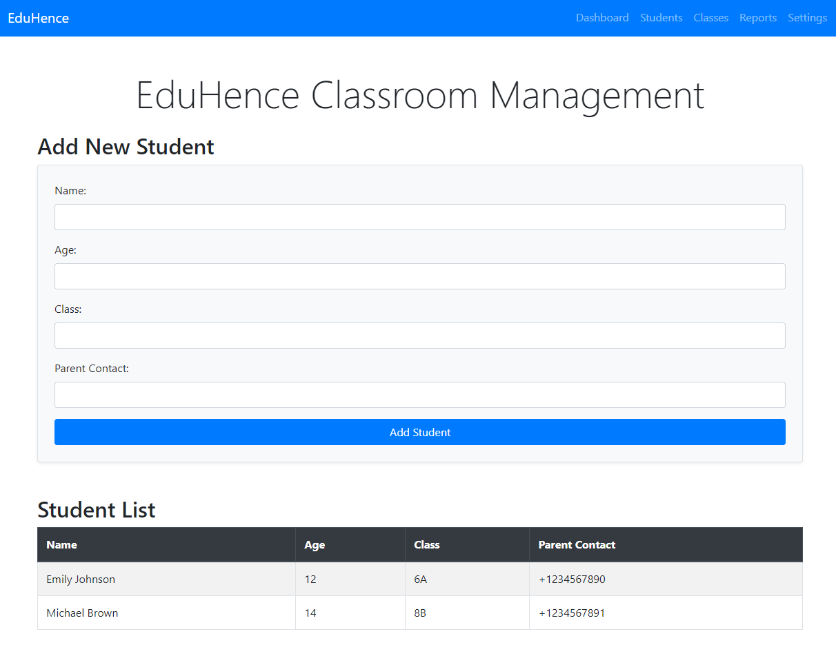
CSS – FINAL EXERCISE
Enhance Your Classroom Management Website with CSS and Responsive Design
✅ Add CSS Styling:
Improve the look and feel of your classroom management website by adding custom CSS styles.
Ensure that the design is visually appealing and consistent.
✅ Use a Responsive Framework:
To make development easier and ensure responsiveness, use any popular framework like Bootstrap, Bulma, or any other framework of your choice.
✅ Ensure Full Responsiveness:
The website should be fully responsive, adapting seamlessly to both mobile and large screens.
Optimize the layout and elements to provide a smooth user experience on different screen sizes.
✅ Update on GitHub:
Once the improvements are complete, commit and push the updated code to your GitHub repository.
👉 This will make your site more professional and user-friendly across all devices! 😎

